Slide 1

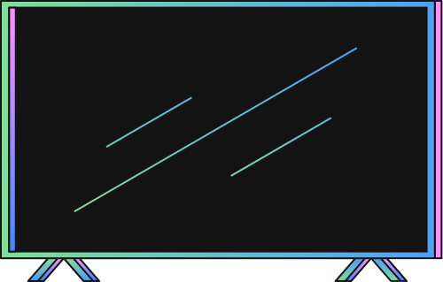
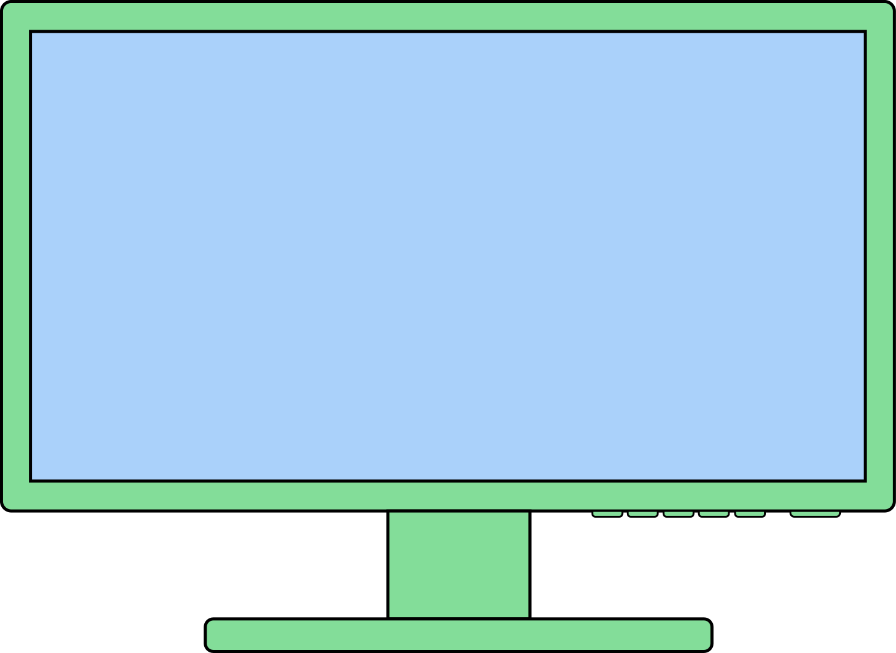

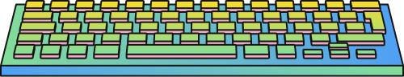

CREATE A GAME IN SCRATCH PROGRAMING
PRESENTED BY
SUBMITTED TO
GRANTHA SAHA
ID:2305010
SESSION:2023-24
DEPT:DATA SCIENCE &
ENGINEERING
RAKIB HASAN
ID:2305015
SESSION:2023-24
DEPT:DATA SCIENCE &
ENGINEERING
TANJIM TAHARAT AURPA
LECTURER-
DEPARTMENT OF
DATA SCIENCE AND ENGINEERING

Slide 2
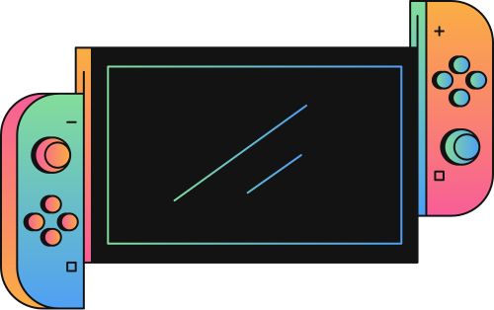
TITLE
GAME IN SCRATCH
SUBTITLE
A FUN AND INTERACTIVE GAME CREATED BY - -
GRANTHA SAHA & RAKIB HASAN
BRICKS 'N' BALL

Slide 3
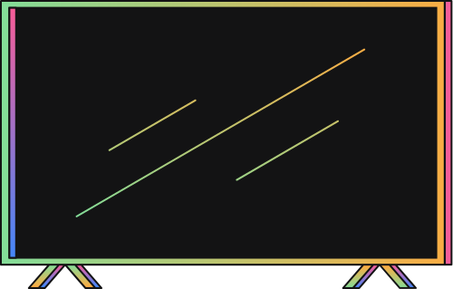
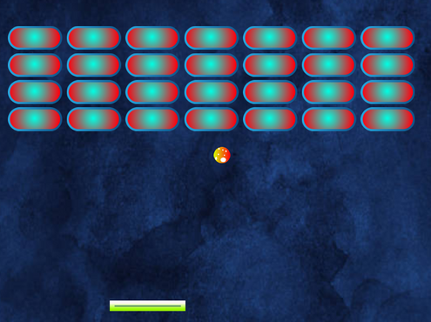
INTRODUCTION
CONTENT:
What is the Brick and Ball Game?
A simple arcade game where players control a paddle to bounce a ball and break bricks.
Why Did I Create This Game?
To learn Scratch programming.
To apply coding concepts in a creative way.
VISUALS OF THE GAME:
BRICKS
BALL
PADDLE

Slide 4
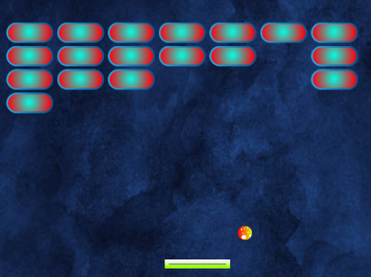


FEATURES OF THE GAME
CONTENT:
User Interaction: The paddle is controlled using mouse.
Gameplay Mechanics:
The ball bounces off walls, bricks, and the paddle.
Bricks break upon collision with the ball.
Players score points as bricks break.
Game Over Scenarios:
Ball falls below the paddle or all bricks are destroyed.
Visuals OF EACH POSTION:
STARTING
BRICKS ARE BREAKING BY BALL
BALL FALLS BELOW THE PADDLE
BRICKS ARE DESTROYED

Slide 5
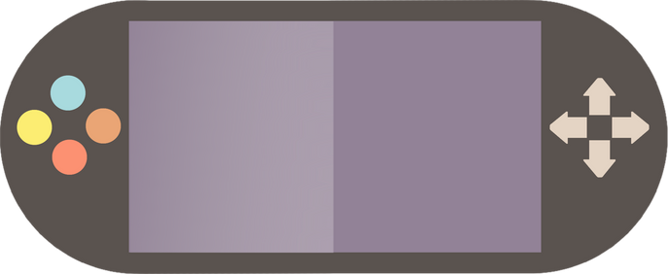
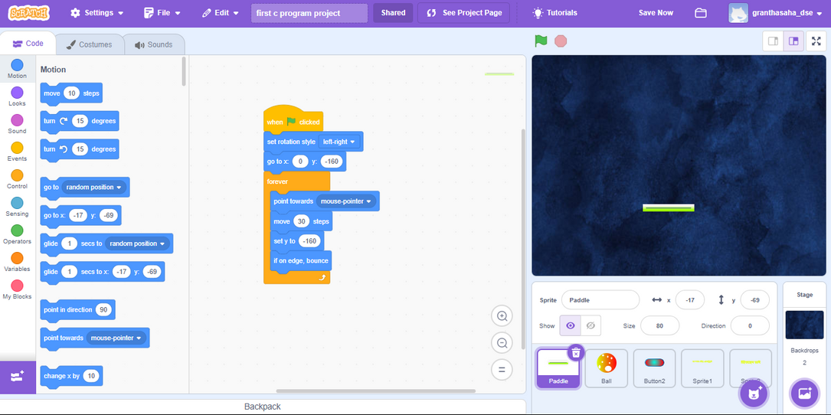
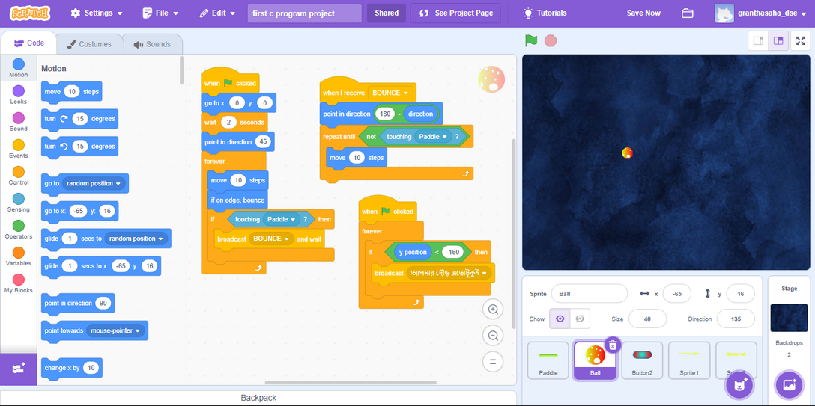
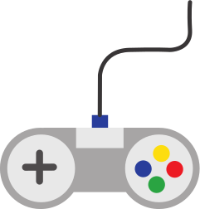


SCRATCH PROGRAMMING CONCEPTS USED
CONTENT:
Key BlOCKS IN SCRATCH:
MOTION BLOCKS: FOR BALL AND PADDLE MOVEMENTS.
CONTROL BLOCKS: FOR LOOPS, IF-ELSE CONDITIONS, AND END-GAME LOGIC.
EVENT BLOCKS: TO DETECT WHEN THE BALL TOUCHES THE PADDLE OR BRICKS.
LOOKS AND SOUNDS BLOCKS: TO CREATE ANIMATIONS AND SOUND EFFECTS.
VARIABLES: USED FOR SCOREKEEPING.
PADDLE CONCEPT
BALL CONCEPT

Slide 6
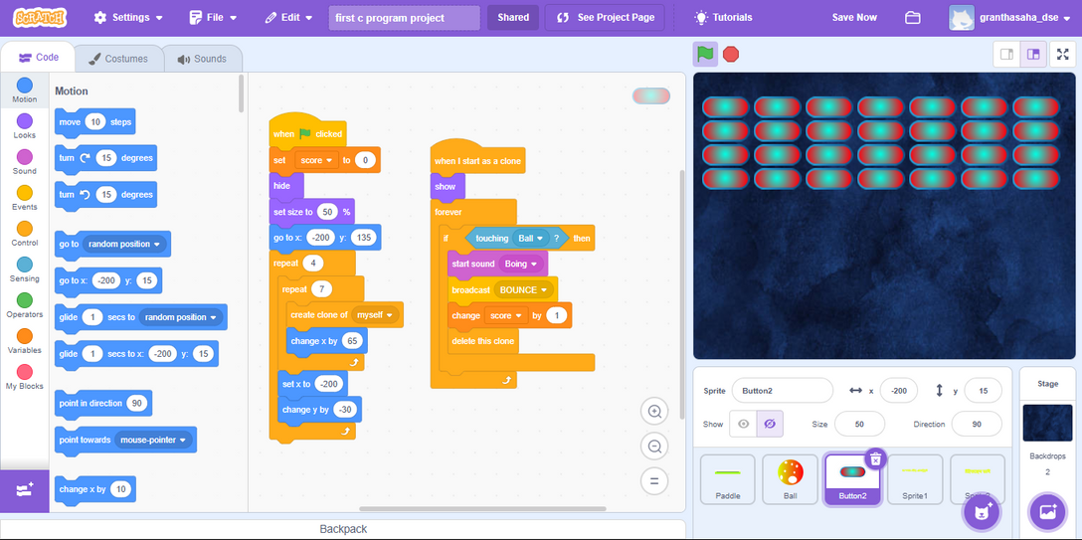
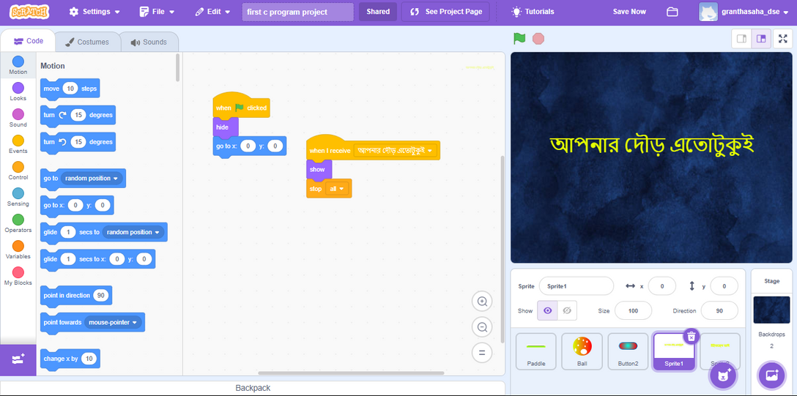
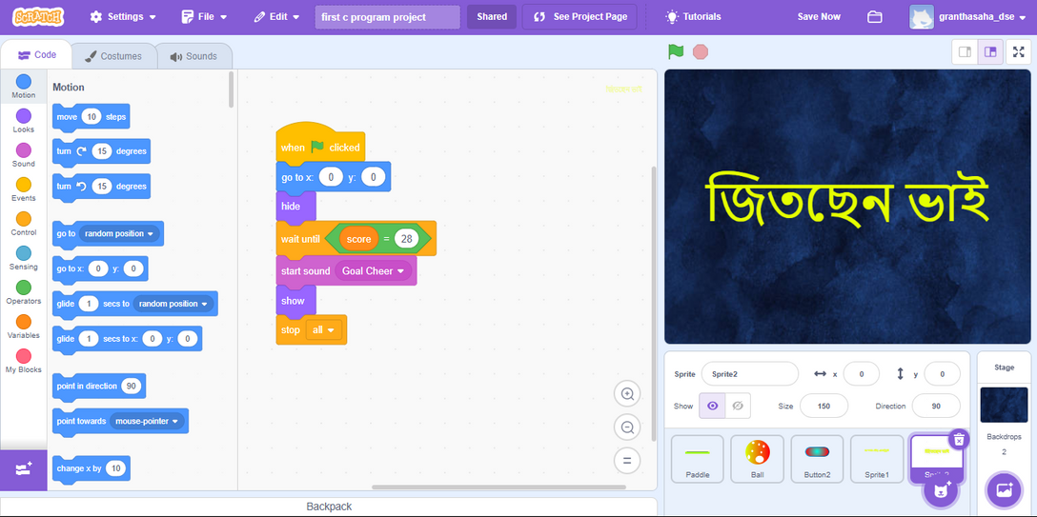
BRICKS CONCEPT
GAME OVER CONCEPT IF BALL FALLS BELOW THE PADDLE
GAME OVER CONCEPT IF ALL BRICKS ARE DESTROYED

Slide 7
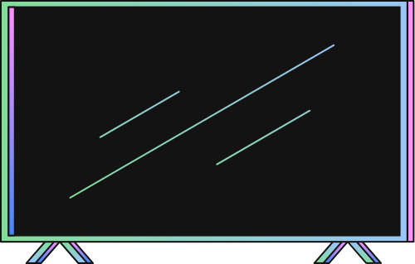

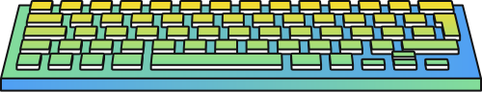
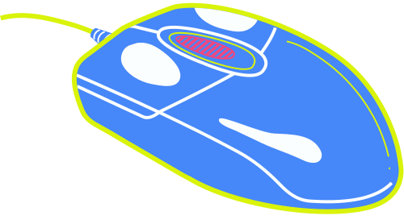
GAMEPLAY DEMONSTRATION
CONTENT:
explain how the game works step-by-step:
Move the paddle to bounce the ball.
Break the bricks to score points.
Avoid letting the ball fall below the paddle.
VISUALS:
LIVE GAMEPLAY:
PLAY
BRICKS 'N' BALL

Slide 8

INSTRUCTION
CHALLENGES AND LEARNING
Challenges:
Making the ball bounce at correct angles.
Ensuring the game is neither too easy nor too difficult.
Debugging issues like the ball getting stuck or paddle not responding.
What I Learned:
Logical problem-solving and debugging.
Using Scratch features effectively.
The importance of user-friendly game design.
FUTURE IMPROVEMENTS:
IDEAS FOR ENHANCEMENTS:
ADD MORE LEVELS WITH INCREASING DIFFICULTY.
INTRODUCE SPECIAL POWER-UPS (E.G., MULTI-BALL OR PADDLE SIZE INCREASE).
CREATE A HIGH-SCORE LEADERBOARD.
MENTION THAT THE GAME IS A FOUNDATION FOR MORE ADVANCED PROJECTS.

Slide 9





Slide 10



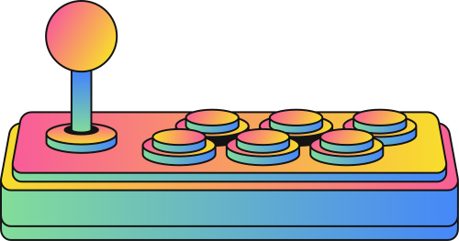
SPECIAL THANKS
TANJIM TAHARAT AURPA MISS
FOR INTRODUCING US TO SCRATCH PROGRAMING

Slide 11

ADVANCE THANKS FOR PLAYING!
END

